Slide 1

Business Report on Sales Performance and Customer Retention
By
The Digital Innovators
Thandi, Phuluso, Kholofelo, Tumisang, Michelle

Slide 2
Business Requirements
The company aims to:
Increase sales revenue by 15% next quarter.
Improve customer retention by 10% through targeted marketing.
Identify high-value customers and optimize pricing.
Boost engagement with personalized incentives and loyalty programs
Data Sources Analysis used:
Sales Transaction Data: Purchase history, pricing trends.
Customer Demographics: Age, location, purchasing behavior.
Customer Feedback: NPS scores, survey responses.
Marketing Data: Email open rates, website activity.

Slide 3
Findings & Insights
Sales Decline: 12% drop in Q4, mainly in electronics and home appliances.
Customer Retention Issue: Repeat purchases contribute only 30% of total revenue.
Personalized Promotions: Potential to increase repeat sales by 25%.
Seasonal Peaks: High sales during holidays, followed by high post-holiday churn.
Recommendations
Implement targeted campaigns with personalized discounts.
Launch loyalty programs with incentive points.
Optimize pricing strategies through competitor analysis.
Enhance post-purchase engagement via emails/SMS.
Improve customer support using NPS survey insights.

Slide 4

Data Analysis & Insights
Key Trends
Seasonal Sales: Peaks in January and December.
Recommendation: Prepare campaigns and inventory for peak months.
Best-Selling Products: Laptops ($2000, 2 sold) and Phones ($3200, 4 sold).
Recommendation: Increase inventory and promotions for tech products.
High-Risk Churn: Customers with 1-2 purchases (e.g., Bongani, Thabo).
Recommendation: Use targeted follow-ups and special offers.
Quantity Trends: Chairs (12 sold) and Monitors (5 sold) indicate bulk buying.
Recommendation: Offer bulk purchase discounts.
High-Value Customers: Fikile and Ntombi ($1600 each).
Recommendation: Develop loyalty programs for high-value customers.

Slide 5
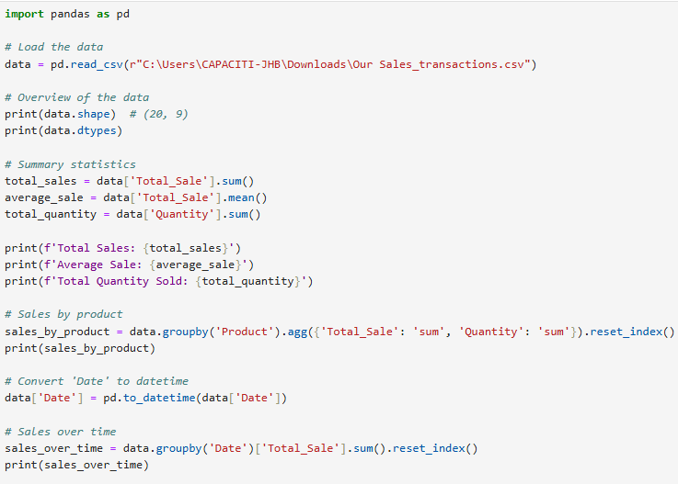
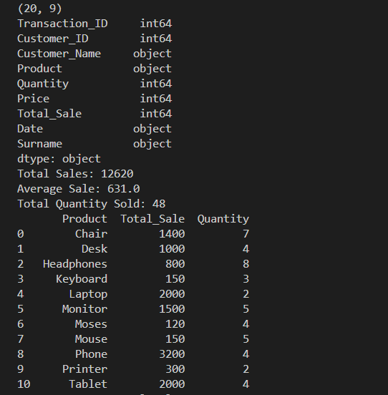
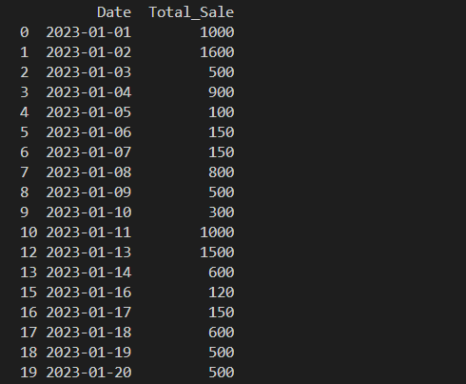
Data Analysis Demonstrations

Slide 6

Designing a Business Dashboard
Dashboard Overview
Title: Sales Dashboard
Focus: Presenting key insights on sales performance and customer retention.
Key Components
Total Sales & Transactions:
Total Sales: $13K
Total Transactions: 20
Visualizations:
Line Chart: Tracks sales trends over time.
Bar Chart: Compares product sales performance.
Pie Chart: Highlights product market share.
Map: Shows geographic sales distribution.

Slide 7
Insights & Recommendations
Sales Trends: Identify top-performing products and adjust inventory accordingly.
Product Performance: Spot underperforming items for targeted marketing.
Market Share Analysis: Focus on best-selling products for strategic decision-making.
Geographical Insights: Optimize marketing for regions with lower sales.
Actionable Strategies: Use data-driven decisions to enhance sales and retention.
Future Considerations: Keep dashboard updated with real-time data for ongoing insights.

Slide 8
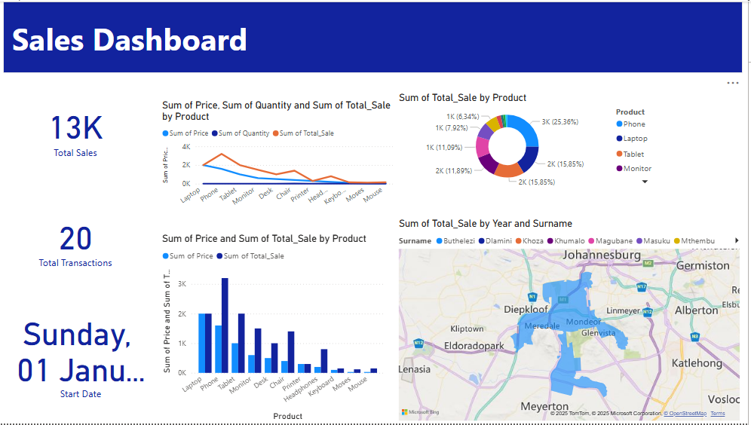
Dashboards Demonstration

